Slide 1

ORIENTATION
TO THE
INTERSTATE COMPACT
Notes:
Welcome, Ladies and Gentlemen, to the very first Webinar of the Children’s Interstate Children’s Compact Commission.
I am Steve Hogan, the Executive Director, and will be your moderator today. Rosemarie Kraeger, the Training and Public relations Committee Chair, is on line with us as well, and it is in support of her committee that the Webinar format we will be trying today. Good Afternoon Rosemarie.
Also with me, is John Mathews and Richard Pryor, from the National Office, who will receive your written questions at any time, but we would prefer that questions through the microphone, be taken at the end of the presentation.
The Purpose of todays Webinar is to orient the audience towards the basic foundation, purpose, scope, and function of the compact, while also testing the viability of this format for future iterations. This is scheduled to be the first of four such hosted Webinars, in support of training the Commission in the states, and other interested stakeholders. We are so very pleased that you were able to join us today

Slide 2
Key Issues
Affecting Military Students
  Typical student experiences between 6-9 transitions
  Adjustment to New School Setting
  Transfer of Services for Special Education
  Incompatible Graduation Requirements
  Redundant / Missed Testing
  Transfer of Coursework and Grades
  Transfer of Records
  Exclusion from Extra-curricular Activities
Academic Issues
Notes:
The military child faces a great many challenges, as the Military family transfer from one assignment to the next in support of our common defense. It has occurred to me, that in this entire equation, the child in a military family is the only individual that did not volunteer for their circumstances, but without doubt must bear the strains and sacrifices that such high mobility entail.
This slide depicts some of the academic challenges that this child must overcome, while being transferred on average six to nine times during their school ages.

Slide 3
Key Issues
Affecting Military Students
Interpersonal Issues Affecting Performance
  Social and Emotional Needs - New Friends/Peers
  Typical deployments vary from 45 days – 1+ yrs
  Deployments can be sudden / no notice
  Recent AF survey showed that even parents who don’t deploy cope more poorly due to increased work load
  Issues can also begin during reintegration when the military member returns
Notes:
Unfortunately, all of the challenges these children face are not academic in nature. The lifestyle, in and of itself demonstrates periods of frequent absenteeism of one or more parent, stress from family member deployments, concern of a loved one in harm’s way, constant re-adjustment to the change in the family unit, from departing, returning, or at home military parents which have an increased workload, and other intangible affects that generate stress on the family group.
This compact, seeks to remove or diminish one aspect of this hardship that affects the military child, by a comprehensive, cooperative, and functional policy of states, who understand the need and are dedicated to lessening the strife that the military child “did not volunteer” to endure.

Slide 4
Background and Status
Developed by The Department of Defense, with assistance from The Council of State Governments
Input and assistance from national associations, federal and state officials, and departments of education and superintendents
Adopted by 48 states and the District of Columbia (approximately 98 percent of military school-age children in the US)
Notes:
For this purpose, the Compact was enacted in 2008, and with a process that has involved professionals from many stratospheres, has continued to grow to the point where nearly 98 percent of military children are offered the same degree of protection afforded from this partnership.

Slide 5
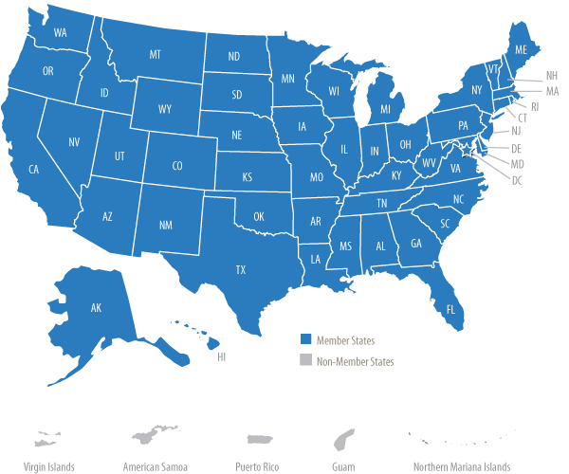
Member States
Notes:
This slide depicts the member states, and District of Columbia, depicted in blue- that are full voting members in the compact.

Slide 6
Major Points
The Compact addresses key educational transition issues encountered by military families including enrollment, placement, attendance, eligibility and graduation.
Children of active duty members of the uniformed services, National Guard and Reserve on active duty orders, and members or veterans who are medically discharged or retired for one year are eligible for assistance under the Compact.
Notes:
This is the first of two slides that illustrate the major points of the Compact.
The focus is on the transitioning the student from one school district to the next, and those issues of enrollment, placement, attendance, eligibility, and graduation articulated in the first bullet will be further explained later in the presentation.
The children of all active component Service members, under USC Title 10, are eligible for protections under the compact. And also those leaving service for a one year time period, after discharge.

Slide 7
Major Points
Compact designed to resolve recognized education transition issues
Compact not intended to impact curriculum or local standards of education
  Recognizes the authority and responsibility of states and local education agencies
  Would have been a major obstacle in obtaining state membership
Notes:
Once again, the focus of the compact is on the “Transition” of the child, and not to dictate or interfere with locally adopted standards of instruction.
I have described this body as a “bridging agent”, that allows the sending and receiving state school districts and compact commissions, with full knowledge of the provisions of the compact, walk together with the family across this bridge.
In doing so, the goal is that the best possible circumstance can be realized for the child, with the least amount of stress or complication.

Slide 8

Compact Content
Article I – Purpose
Article II – Definitions
Article III – Applicability
Article IV – Enrollment
Article V – Placement and Attendance
Article VI – Eligibility
Article VII – Graduation
Article VIII – State Coordination
Article IX – Interstate Commission
Notes:
This slide depicts the articles of the compact, as they currently exist. We will be discussing the ones depicted in Red individually,

Slide 9

Article IV - Enrollment
Educational Records
Immunizations
Entrance Age (Kindergarten)
Notes:
Article four, deals with issues surrounding enrollment of the child with the intention of streamlining this process as much as possible.
It allows for Educational records to be hand carried, unofficially, from one state to the next, while official records are in transport through the normal channels, for conditional enrollment and placement of the student.
It further establishes the standard for the transfer of official records to a ten day span of time, if the parents are not permitted to hand carry the official records.
For Immunizations, students will have a 30 day time period, once enrolled, to obtain the proper immunizations and vaccines.
Kindergarten and first grade students shall be enrolled at their previously achieved level of the sending state, regardless of age

Slide 10

Article V - Placement and Attendance
Course and Program Placement
Special Education Services
Placement Flexibility
Absence Related to Deployment
Notes:
In Article five, placement and attendance, the compact stipulates that the receiving state shall initially honor the placement of a student at the point in their educational career where the sending state ended.
This pertains to Honors courses, advanced placement, vocational training, etc. Essentially, this function of the compact seeks to be he bridging agent described earlier, and the least disruptive option, generally.
The Receiving state still have the authority to subsequently assess the student, and determine if this placement is the best course for the student
Special education requires comparable services, to be provided for those students with special needs, based upon the child’s current Individualized Education Program- and is in compliance with the Individuals with Disabilities Education Act, in order to provide the special needs military child with equal access to education.
Subsequent evaluations to determine further courses of action are also discussed, as appropriate, and within the authority of the receiving state.
In respect to absences related to deployment activities, excused absences of a reasonable duration are stipulated for a child with a parent either returning from, or departing to a combat zone deployment. This amount of excused absence is left at the discretion of the superintendent

Slide 11

Article VI – Eligibility
Enrollment
Extracurricular Participation
Notes:
In Article six, eligibility and enrollment provisions are stipulated.
Essentially, it allows a special power of attorney guardianship for a military child who has been placed in the care of a non-custodial parent.
It allows the child to remain enrolled if the non-custodial guardian residence is outside of the normal school district, while prohibiting the district from charging tuition if this condition exits.
Further, inclusion in extracurricular activities will be facilitated, to the extent of the child’s abilities and qualification.

Slide 12

Article VII – Graduation
From Receiving State
From Sending State
Exit Exams
Notes:
in article seven, the compact addresses graduation requirements, which is likely the aspect of the compact with the greatest urgency and impact.
Essentially, it looks to cooperative solutions to ensure that a student, who has measured up to their part of the bargain, will not be delayed receiving a diploma if their schools change before or during their senior year.
The receiving state has latitudes to accept or waive required coursework, if similar coursework had been completed, or to identify alternative solutions to facilitate an on time graduation.
If the receiving state is not able to award a diploma, and with all other alternatives being considered, the sending state school may award a diploma contingent upon their own standards, so that again the student will graduate on time.
Additionally, the states shall accept exit exams or end of course exams from the sending state, if practical.

Slide 13
National Commission Duties
Establish by-laws for the Commission’s governance and for directing the Commission’s actions or conduct.
Establish rules to effectively and efficiently achieve the purposes of the Compact.
Monitor compliance and initiate interventions to address and correct noncompliance.
Coordinate training and education regarding regulations.
Elect the Executive Committee and establish other committees as necessary.
Notes:
The National Commission consists of the 46 states and one district, as described prior, and each member state is represented on the National Commission with one voting member.
Depicted here, are the management duties and responsibilities of the National Commission.

Slide 14
State Governance
State coordination is governed by Article VIII of the Interstate Compact.
Each State has:
  State Commissioner
  State Council
  Military Family Education Liaison
Notes:
Each state, in turn, sets up its own Commission, governed by Article 8 of the Compact.
The State Commissioner, serves as the primary point of contact for all Interstate business, and will be advised by the National Commission, National Executive Committee, or National Office on any matter of impact to his state.
The State Council membership will be determined by the state, as a body, but must include:
The State SPT of Ed
SPT of a school district with a high concentration of military children
Rep. from a Military installation
Rep(S) from the Legislative and Ex. Branch of Gov.
And other stakeholders as the state council deems appropriate.

Slide 15
Role of State Commissioner
Compact mission & purpose are promoted
Appointment is compliant with Statute
State Council is functioning
Adequate Resources are available
  Staff
  Training
  Capabilities/ Technology
Notes:
At the National Office, we view the State Commission as the center of gravity, and also the engine of progress for the entire execution process.
The State Commissioner in each state, is responsible for ensuring the following depicted on the slide, which is the first of two slides.

Slide 16
Role of State Commissioner
Dues are paid
Informal disputes are handled
Working relationships are developed and maintained with:
  National Office
  Education Departments
  State Council Members
  School Liaison Officers
  Other Commissioners
  Military Installations
Notes:
This is the second slide that depicts the Role of the State Commissioner.
The last bullet that speaks to working relationships is the most informative, in that through state to state collaboration, and good faith exhibited by all parties concerned, the Compact will meet its purpose and scope.

Slide 17
State Council Responsibilities
Designed to serve as an advisory and advocacy body
May be tasked with development of policy concerning operations and procedures of the compact within that state.
Assist the State Commissioner with their responsibilities.
Promote and advocate the Interstate Compact to school administrators
State Compact language may differ from the Model, particularly as related to members of the state council (refer to the Compact as adopted in your state.)
Notes:
This depicts the responsibilities of the state Council. Essentially, it advises, develops policies, and promotes the decentralization of the compact for execution at the local education agency level.
The last bullet, depicted in Red, acknowledges that state compacts from state to state will differ from the model language on occasion, while maintaining the overarching intent.

Slide 18
Role of National Office
Secretary/Clearinghouse
to the Commission
  Documents
  Meeting Minutes
  Commission Business
Resource Center
  Technical & Training Assistance
  Publications
  Website
  Directory of States Compact Offices
  Legal Assistance/Opinions
Notes:
My function as Ex dir. at that of the MIC3 staff, is to act as the secretariat of the national Commission, and National Executive Council, while providing assistance to the state commissions as necessary.
Ordinarily, we act as a facilitator between the states, or an executor for the National bodies.

Slide 19
Services Provided
#1 Priority is to serve the Commission
  Assist Commission, Committees & State Commissions in carrying out respective missions/goals
  Logistical support
    Teleconference/Web conferences
    On-site Meetings/Trainings
Notes:
These are the services provided from the National office to the Commission membership.
As the green highlighted portion attests, any activity that furthers the interests of the greater commission, is our absolute priority- even if the tasks are not mentioned here.
Logistical support, as in today’s webinar, are also conducted as needed.

Slide 20
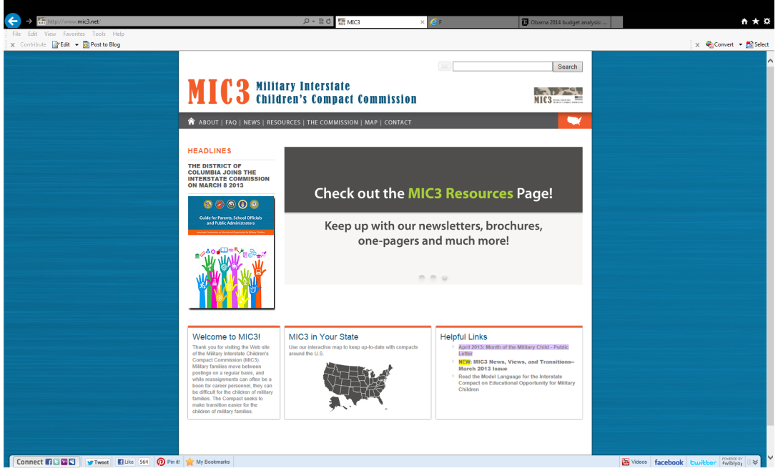
MIC3 Website www.MIC3.net
#1 communication/resource center
Updated frequently
Directory of State Compact Offices
Discussion Forums
Notes:
This slide refers to the MIC3 website, which is the central communications hub for facilitation of activities.
It is a very detailed, and often used resource in many areas, designed to facilitate service to the commission, and the general populace that have questions or require assistance.

Slide 21
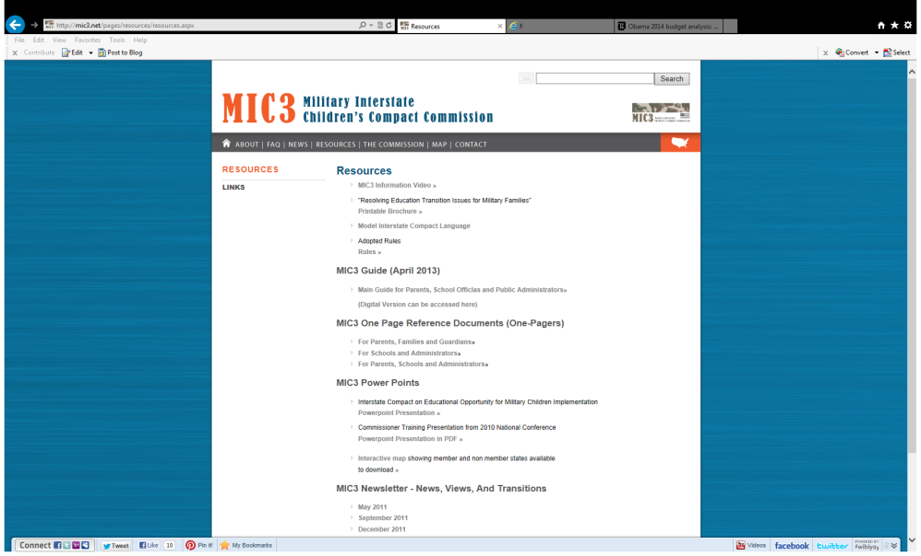

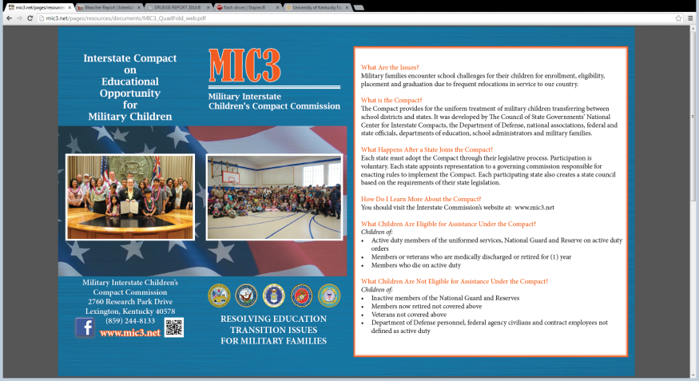
Training Assistance
  Presentations
  Manuals
  Supplemental Materials
  Rules
  Legal
Notes:
This slide depicts some of the training assistance devices that are constructed, for use in furthering the training of State Commissions, School Liaison officers, etc.

Slide 22
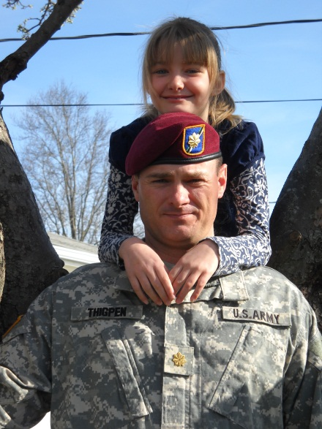
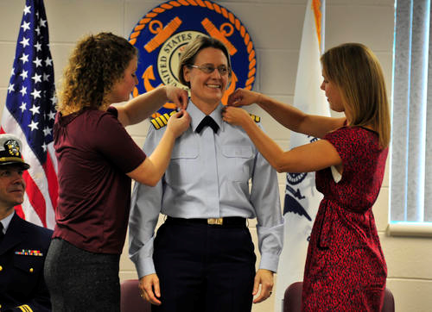
Interstate Compact Issues
Case Studies
Kindergarten/1st grade entry
Enrollment
Placement
Eligibility
Extra-curricular
Exit Exams
Graduation
Each situation is unique – gather all the information before determining how the Compact applies.
Notes:
At this time, I would like to open discussion to the field, and invite anyone to discuss a circumstance, success or failure, of the Compact where the provisions were useful in a final determination?

Slide 23






The Compact provides a valuable tool to help our military families!
Notes:
In terms of summary, this slide really speaks for itself.

Slide 24
Contact
Interstate Commission on Educational Opportunity for Military Children
PO Box 11910
Lexington KY 40578-1910
(859) 244-8069 Phone
(859) 244-8001 Fax
Commission Website
  www.mic3.net

Slide 25
Outcomes…as a result of this webinar
We will learn why the Interstate Compact was formed.
We will identify the major aspects of the Interstate Compact.
We will identify the major Compact Content areas.

Slide 26
Why have an Interstate Compact?
Reassignments usually play havoc with the children of military families:
  losing and making new friends
  adjusting to new cities and bases
  changing schools
Much remains to be done at the state and local levels to ensure that the children of military families are afforded that same opportunities for educational success not penalized or delayed in achieving their educational goals.
Most military children will have six to nine different school systems in their lives from kindergarten to 12th grade.

Slide 27
Interstate Compact in Law
The Interstate Compact is adopted as law by the State Legislature.
Certain parts may vary from state to state, but the bulk of the Interstate Compact is the same.
(Place State Statute of Code reference HERE)

Slide 28
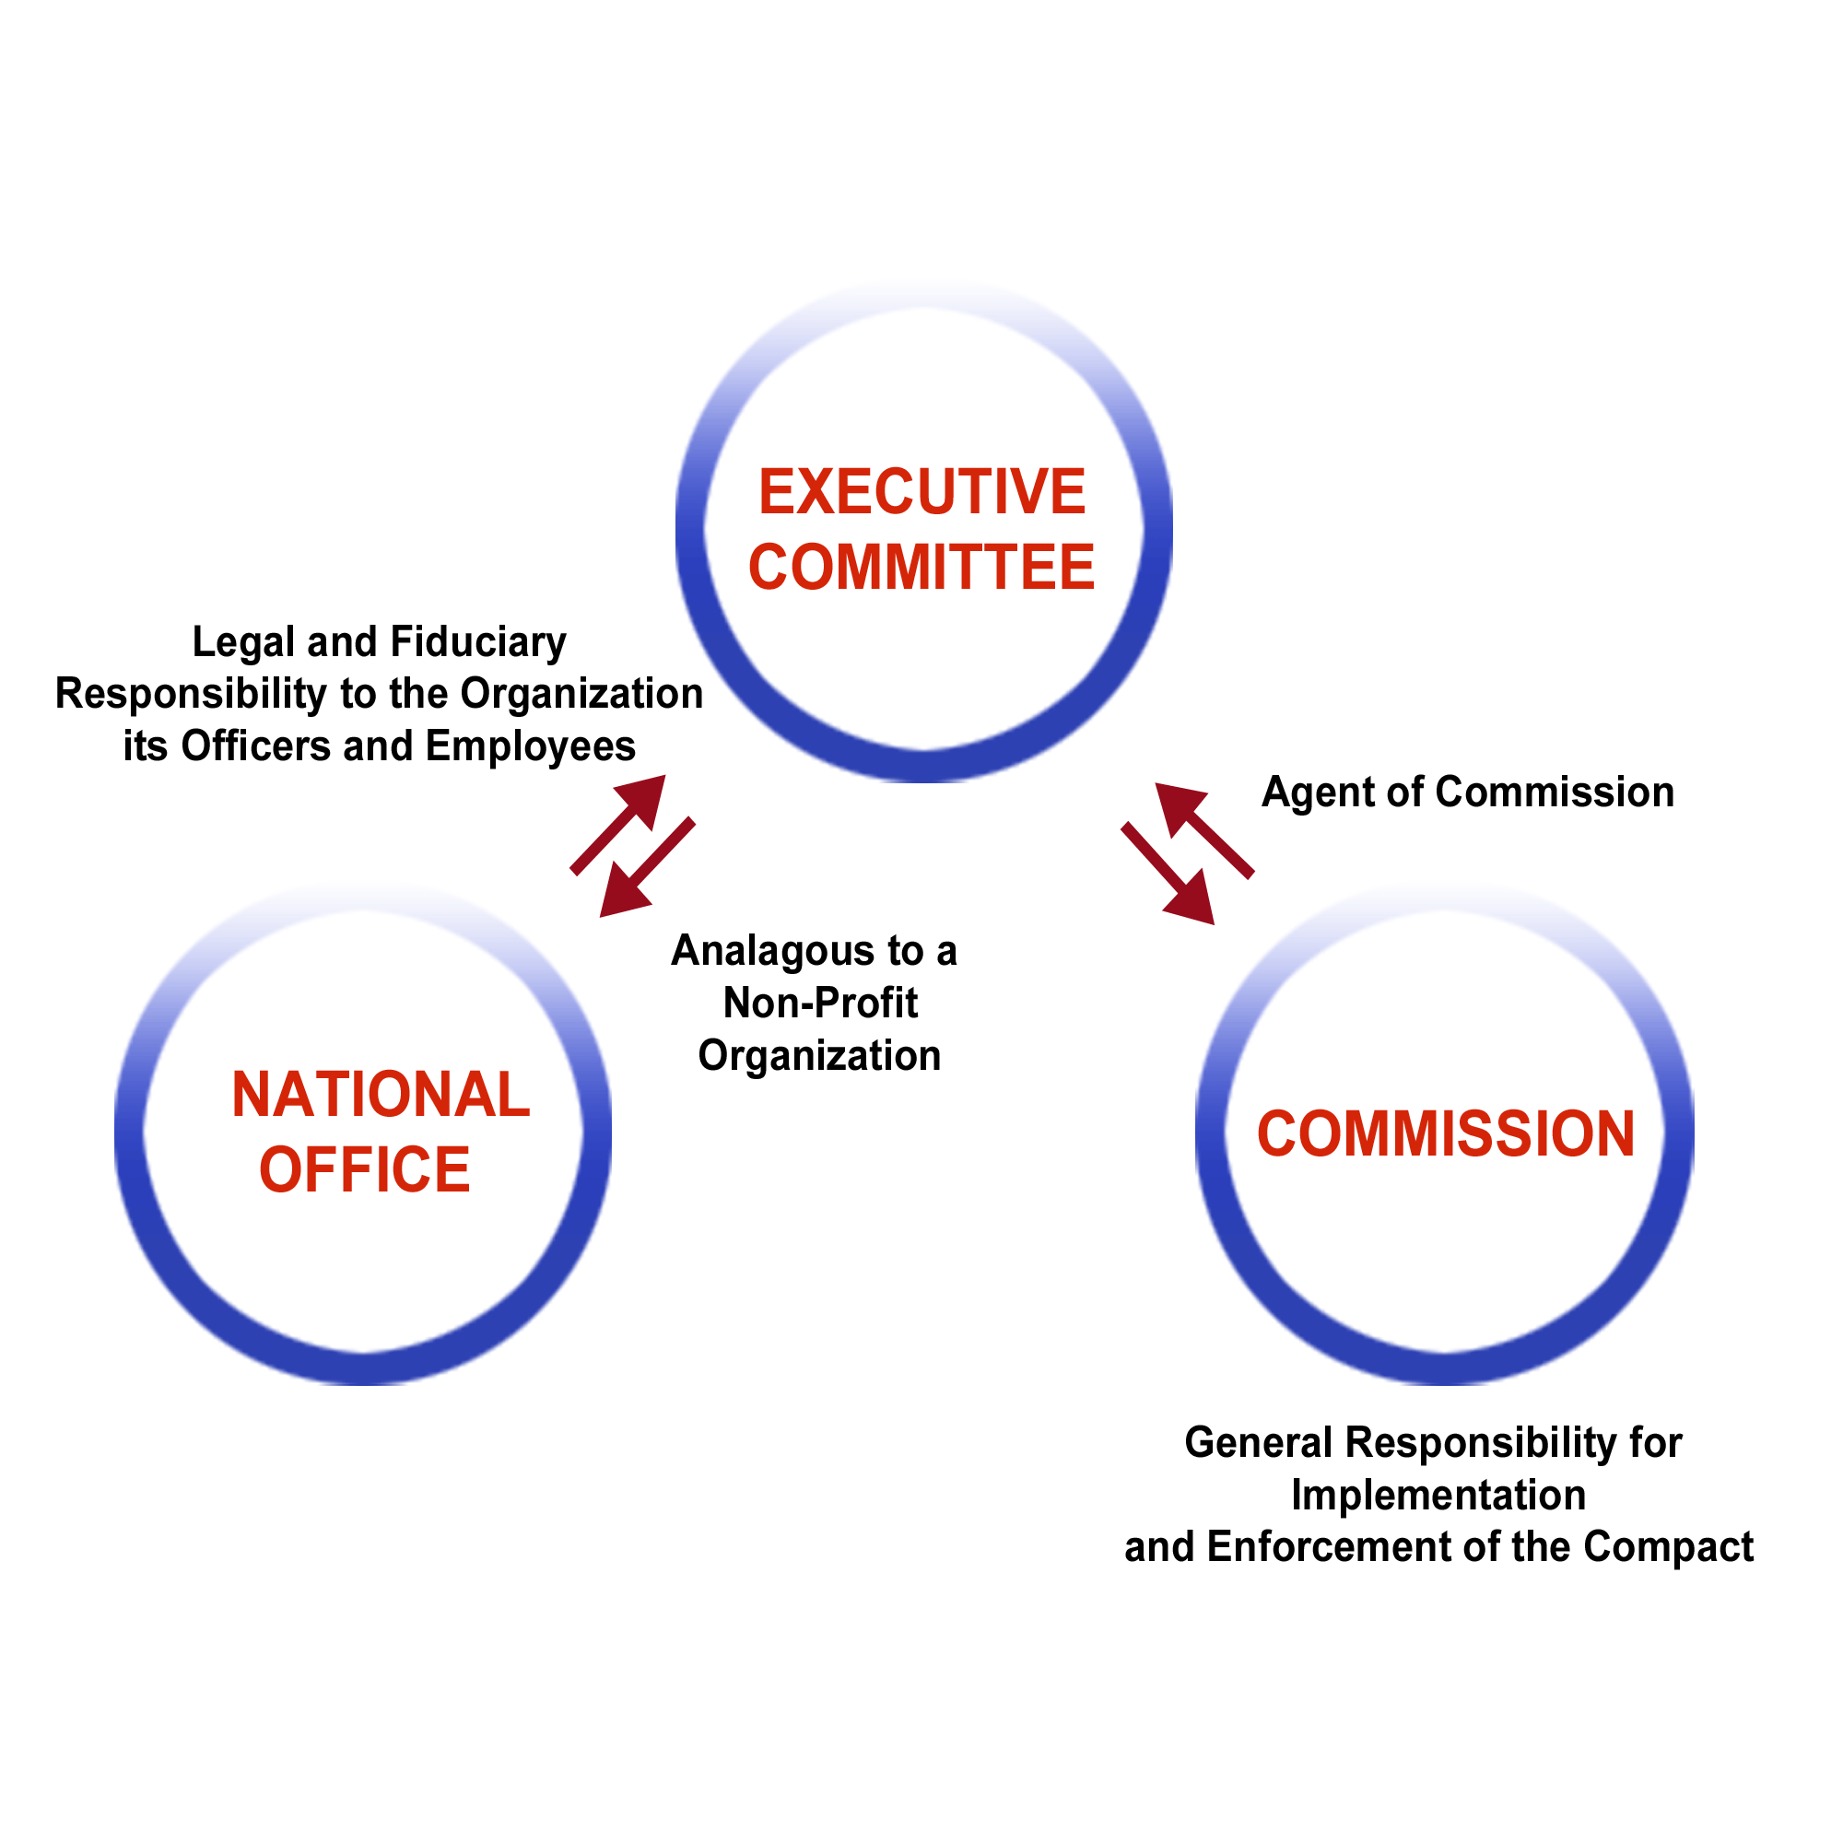
MIC3 Workflow Model

Slide 29
MIC3 Organization
Executive Director
Stephen R. Hogan
General Counsel
Rick Masters
(Contract Employee)
Program Specialist
John Matthews
Operations Coordinator
Richard Pryor

